Slide 1
Teal Organization

Slide 2
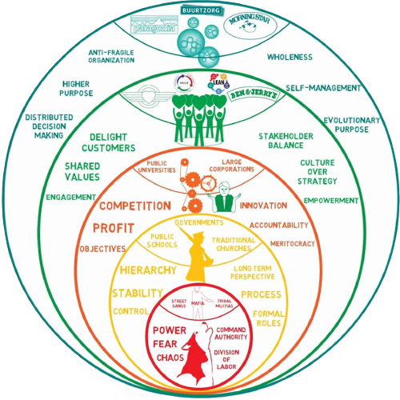
Nowadays, teal is the last step in what organization management refers.

Slide 3
It has three basic principles
Self-management
Instead of a pyramid made of a top with all the power and a bottom with none at all.
Teal works by giving all the same power by implementing self-management teams, those teams work as mini organizations with all its corresponding roles, and they manage themselves with the objective to make the hole organization better.
Wholeness
In teal people put all they have to do what they have to do, they're not behind a professional mask or a rule made by the highest level of the organization.
They can put their feelings, knowledge, vulnerabilities, personality, to unlock their true potential to make the best of what they're doing. But for that, a safe and open environment is needed.
Evolutionary purpose
Profits are seen as the result of doing a great job.
So instead of focusing on market share, competition, times or maximizing the money obtained, teal focuses on accomplishing the objective of the organization, whatever that one may be.

Slide 4

An example of teal organization

Slide 5
“We started working with different countries and discovered that the problems are the same. The message every time is to start again from the patient perspective and simplify the systems.”
Jos de Blok, Buurtzorg founder

Slide 6
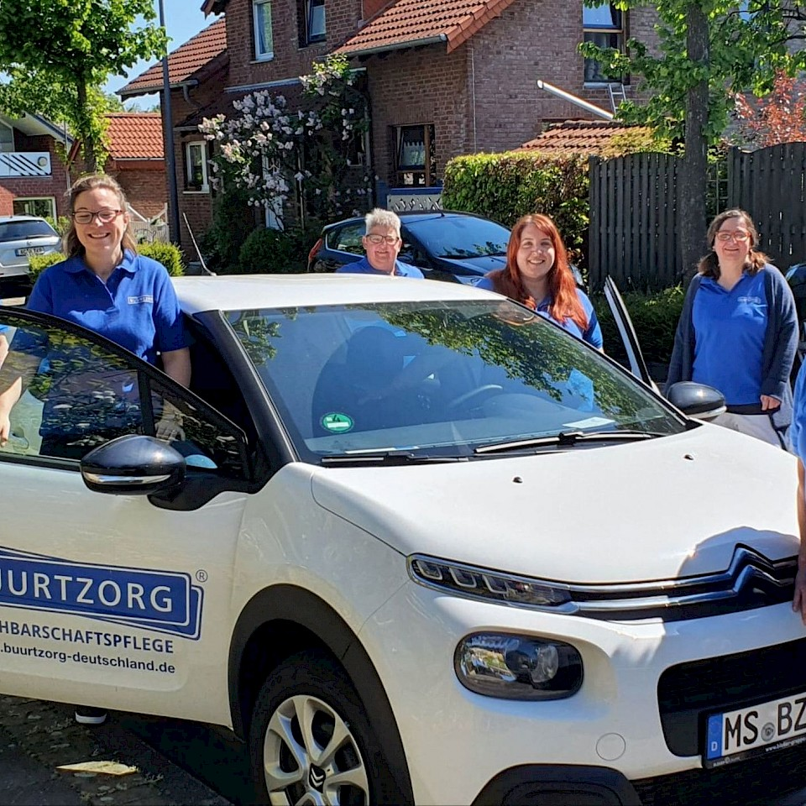
Buurtzorg is a health care organitzation that reavolutionized the health care by using a holistic model applied by self-managed teams.
The base relies on empowering nurses to deliver all the care the patients needs.

Slide 7
How Buurtzorg started?
Four nurses seen that the traditional command and control method, where nurses work for its superiors, wasn’t effective. They set up a new method based on freedom trust and autonomy, that will benefit everyone inside the health care process.

Slide 8
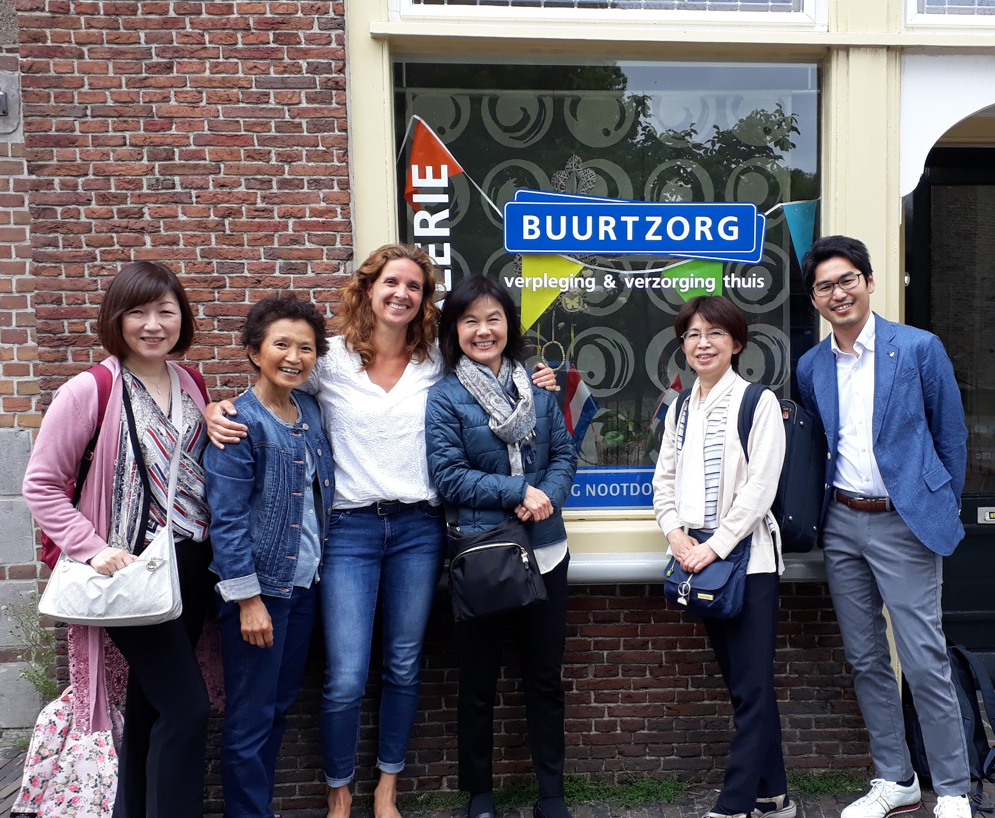
In the start the groups are made from six people, and each group takes care of a group of patients, normally a neighborhood.
While they're working they make more nurses join the group, when the group grows to twelve it splits into two groups and distribute or obtain more patients.

Slide 9
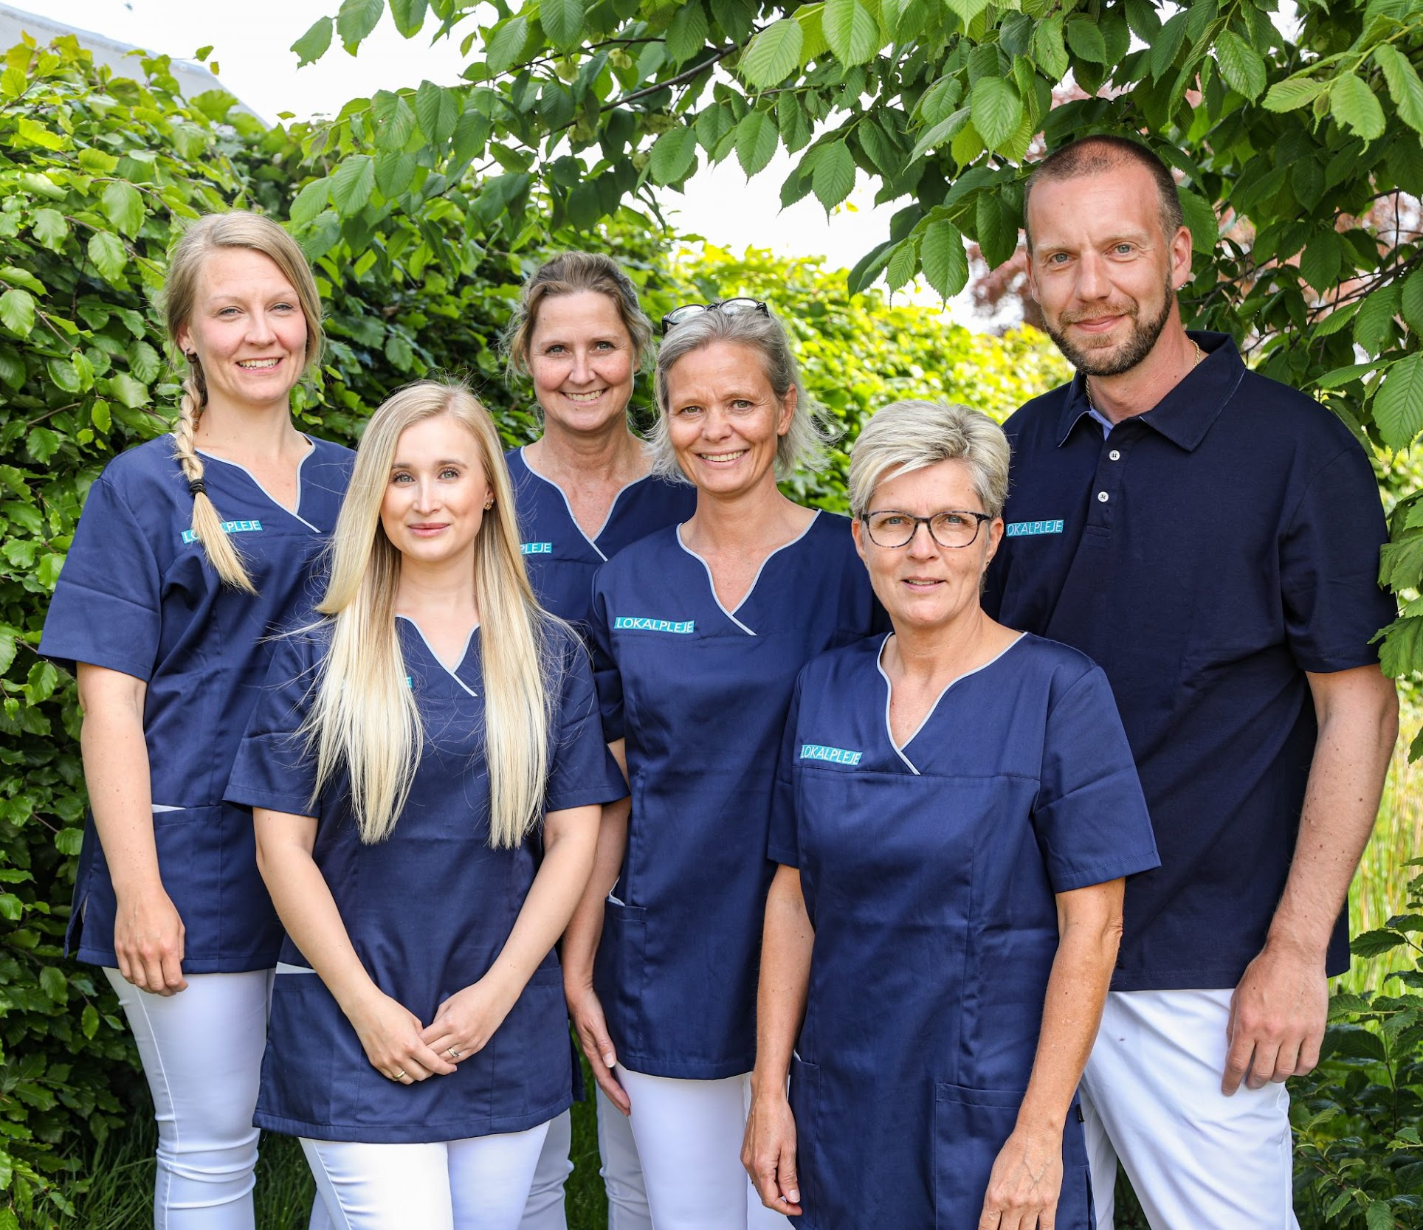
SELF-MANAGEMENT?
That means that each group takes care of:
Nursing
Planing
Personal development
Recruitment
Hiring
Firing

Slide 10
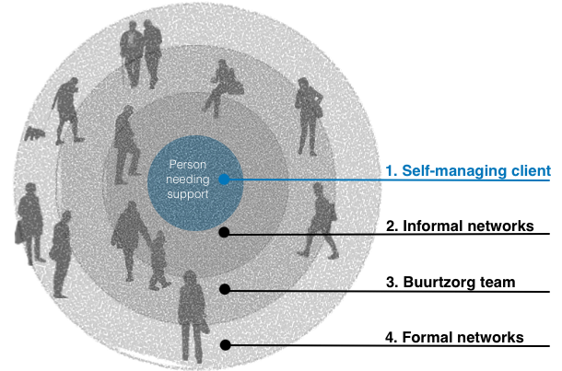
The client stays in the center and self-managed teams work to satisfy its necessities

Slide 11
Organization of the organization
Support team:
A network that big needs a group of people to organize it, but it only represents the 0.4% of the workforce.
Coaches:
When a team encounters a problem that can not be resolved by itself, they go to a group of 20 coaches to obtain the needed help to solve it.
Those coaches also have two directors.
Buurtzorg web:
It’s the intranet used by all the organization members to share knowledge compare performance, create alignment and obtain advice from experienced members if needed.
Also lets the CEO to send global messages.

Slide 12

Compared to the other health care methods/companies, buurtzorg has:
+30% Client Satisfaction
-33% Staff absentism
-50% Staff turnover
-67% Overhead costs
Also the patients are healed faster

Slide 13
Web bibliography
https://www.buurtzorg.com/
https://www.youtube.com/watch?v=61TT2_Vo32Y
https://isocial.cat/innovacio/buurtzorg-equips-autonoms-datencio-domiciliaria/
https://en.wikipedia.org/wiki/Buurtzorg_Nederland
https://www.strategy-business.com/article/00344
https://en.wikipedia.org/wiki/Teal_organisation
https://www.iberdrola.com/talent/teal-organisations

